Slide 1
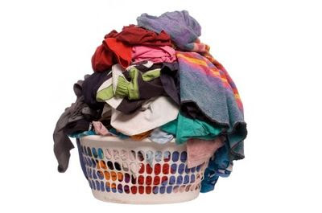
Dressing To Meet Christ:
Putting Off The Dirty Clothes

Slide 2
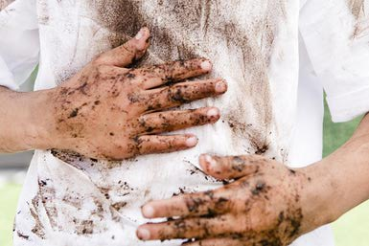
Removal of Earth-Stained Garment
Put To Death (To Make Dead)
  More than simple suppression
  These vices will kill if they are not killed

Slide 3
Removal of Earth-Stained Garment
Sexual Immorality
  Sweeping term for prohibited sexual relations
  Proverbs 5:15-23
  Applicable to:
    Fornication
    Adultery
    Homosexuality
      Romans 1:27-28

Slide 4
Removal of Earth-Stained Garment
Impurity
  Uncleanness of thought, word, or act
  Deals primarily with mindset leading to action
The good person out of the good treasure of his heart produces good, and the evil person out of his evil treasure produces evil, for out of the abundance of the heart his mouth speaks. – Luke 6:45

Slide 5
Removal of Earth-Stained Garment
Impurity
  Uncleanness of thought, word, or act
  Deals primarily with mindset leading to action
  Creates fertile ground for sinful thoughts

Slide 6
Removal of Earth-Stained Garment
Passion and Evil Desire
  Uncontrolled desire that contaminates character
Transgression speaks to the wicked deep in his heart; there is no fear of God before his eyes. For he flatters himself in his own eyes that his iniquity cannot be found out and hated. The words of his mouth are trouble and deceit; he has ceased to act wisely and do good. He plots trouble while on his bed; he sets himself in a way that is not good; he does not reject evil. –Psalm 36:1-4

Slide 7
Removal of Earth-Stained Garment
Covetousness
  Greediness and total disregard for others
  Belief everything exists for personal pleasure
    Reason for association with idolatry

Slide 8
Removal of Earth-Stained Garment
And Why Put These Away?
  Practitioners will be brought into judgment (vs. 6)
  It represents the old life (vs. 7)

Slide 9
Removal of Earth-Stained Garment
List Two
Anger and Wrath
  Deep seated hostility with eventual flare
  Simmering, not seen on the surface until flare
Whoever is slow to anger is better than the mighty, and he who rules his spirit than he who takes a city. – Proverbs 16:32

Slide 10
Removal of Earth-Stained Garment
List Two
Malice
  General ill-will toward others
  Seeks to find the occasion for anger to flare
Brothers, do not be children in your thinking. Be infants in evil, but in your thinking be mature. -- I Corinthians 14:20

Slide 11
Removal of Earth-Stained Garment
List Two
Malice
  General ill-will toward others
  Seeks to find the occasion for anger to flare
So put away all malice and all deceit and hypocrisy and envy and all slander. -- I Peter 2:1

Slide 12
Removal of Earth-Stained Garment
List Two
Slander
  Speech putting malice into practice
  Its purpose is to destroy
The one who conceals hatred has lying lips, and whoever utters slander is a fool./Whoever slanders his neighbor secretly I will destroy. – Pr.10:18/Ps.101:5

Slide 13
Removal of Earth-Stained Garment
List Two
Obscene Talk
  “Foul-mouthed abuse”
  Attempt to cause harm to another

Slide 14
Removal of Earth-Stained Garment
List Two
Do Not Lie To One Another
  Perhaps most common and hardest to control
  No excuses!

Slide 15
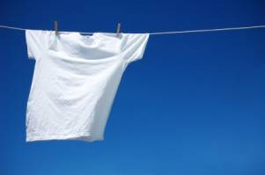
Motivation To Change
These Are Qualities of “Old Self”
They Are Unlike God
  Colossians 3:10
  Are You Ready
  To Change?

